Slide 1
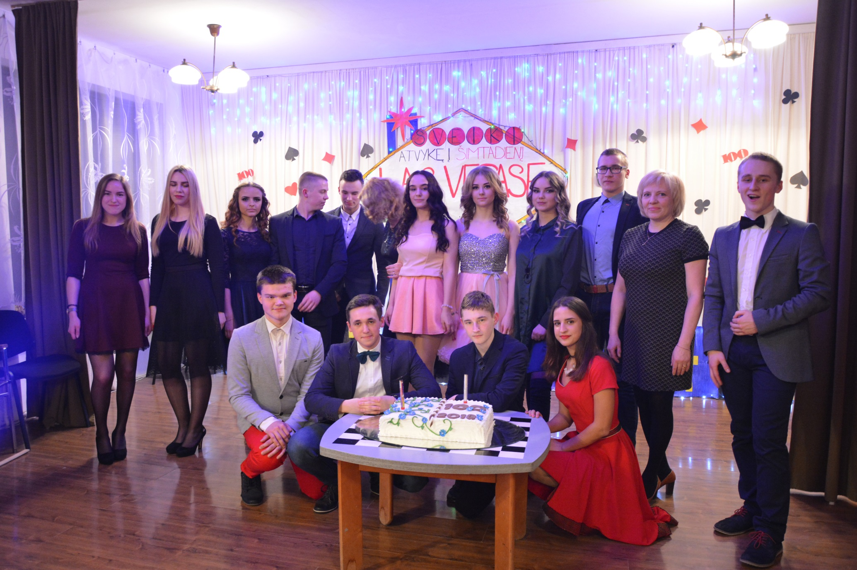
The traditional school event Hundred days are left

Slide 3
The celebration of the Freedom fighters day on the 13 of January

Slide 4
The Creative Workshop before Christmas 2017

Slide 6
The traditional Christmas festival

Slide 8
Project ,,Say thank you“

Slide 9
The making of straw dolls

Slide 10
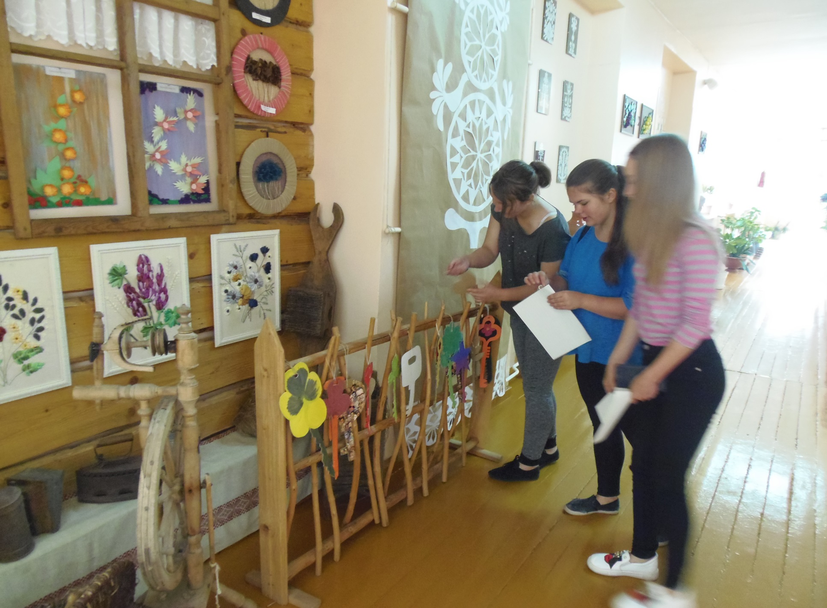
The commemoration of The Mourning and Hope day / The 14 th of June

Slide 11
The traditional dancing festival ŠALČIOS ALELIUMAI

Slide 12
Action ,,Let's hug the earth“

Slide 13
A lesson with a circus clown

Slide 14
The song festival,,because of our Homeland.....“

Slide 15
The teachers fashion show the 5th of October

Slide 16
The last day at school before summer holidays. The dancing and playing games evening called May

Slide 17
The leaving school party

Slide 18
Christmas carnival

Slide 19
Kaziukas fair

Slide 20
A trip around the region Aukštaitija

Slide 21
In Kernave

Slide 22
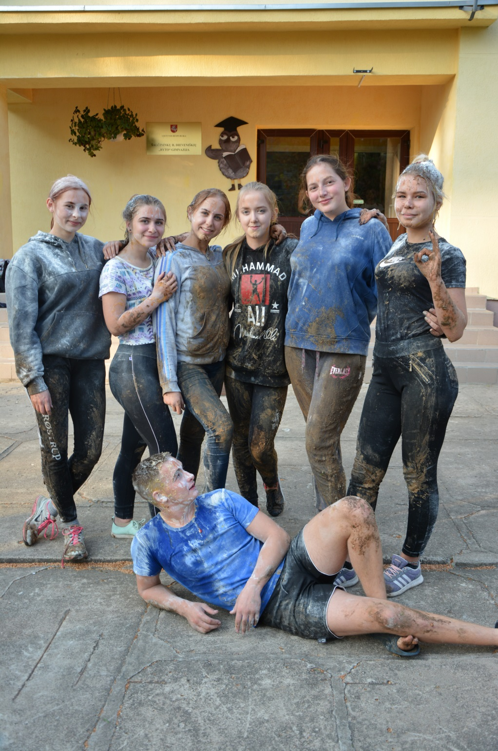
The Immatriculation festival

Slide 23
The mothers day

Slide 24
We are painting eggs before Easter

Slide 25
The Grandparents festival

Slide 26
The teachers day

Slide 27
The teachers disco party

Slide 28
II g class last Bell festival

Slide 29
The last bell of primary school students

Slide 30
The last Bell of 12th class formers

Slide 31
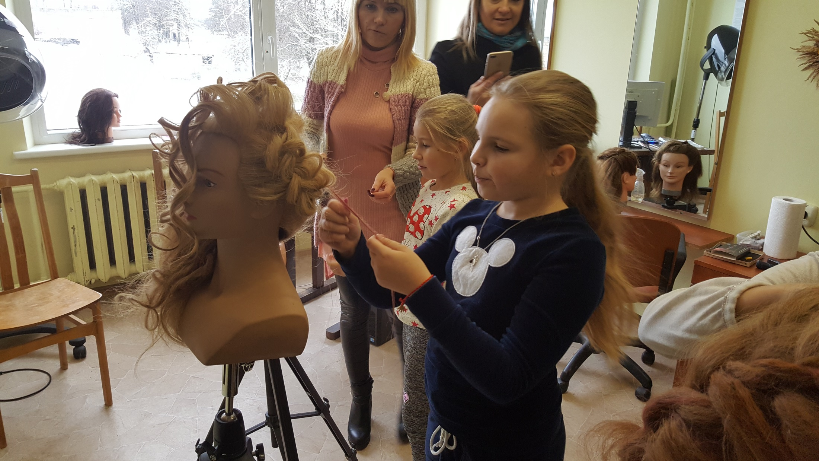
Professions consultation lessons in Dieveniskes vocational school

Slide 32
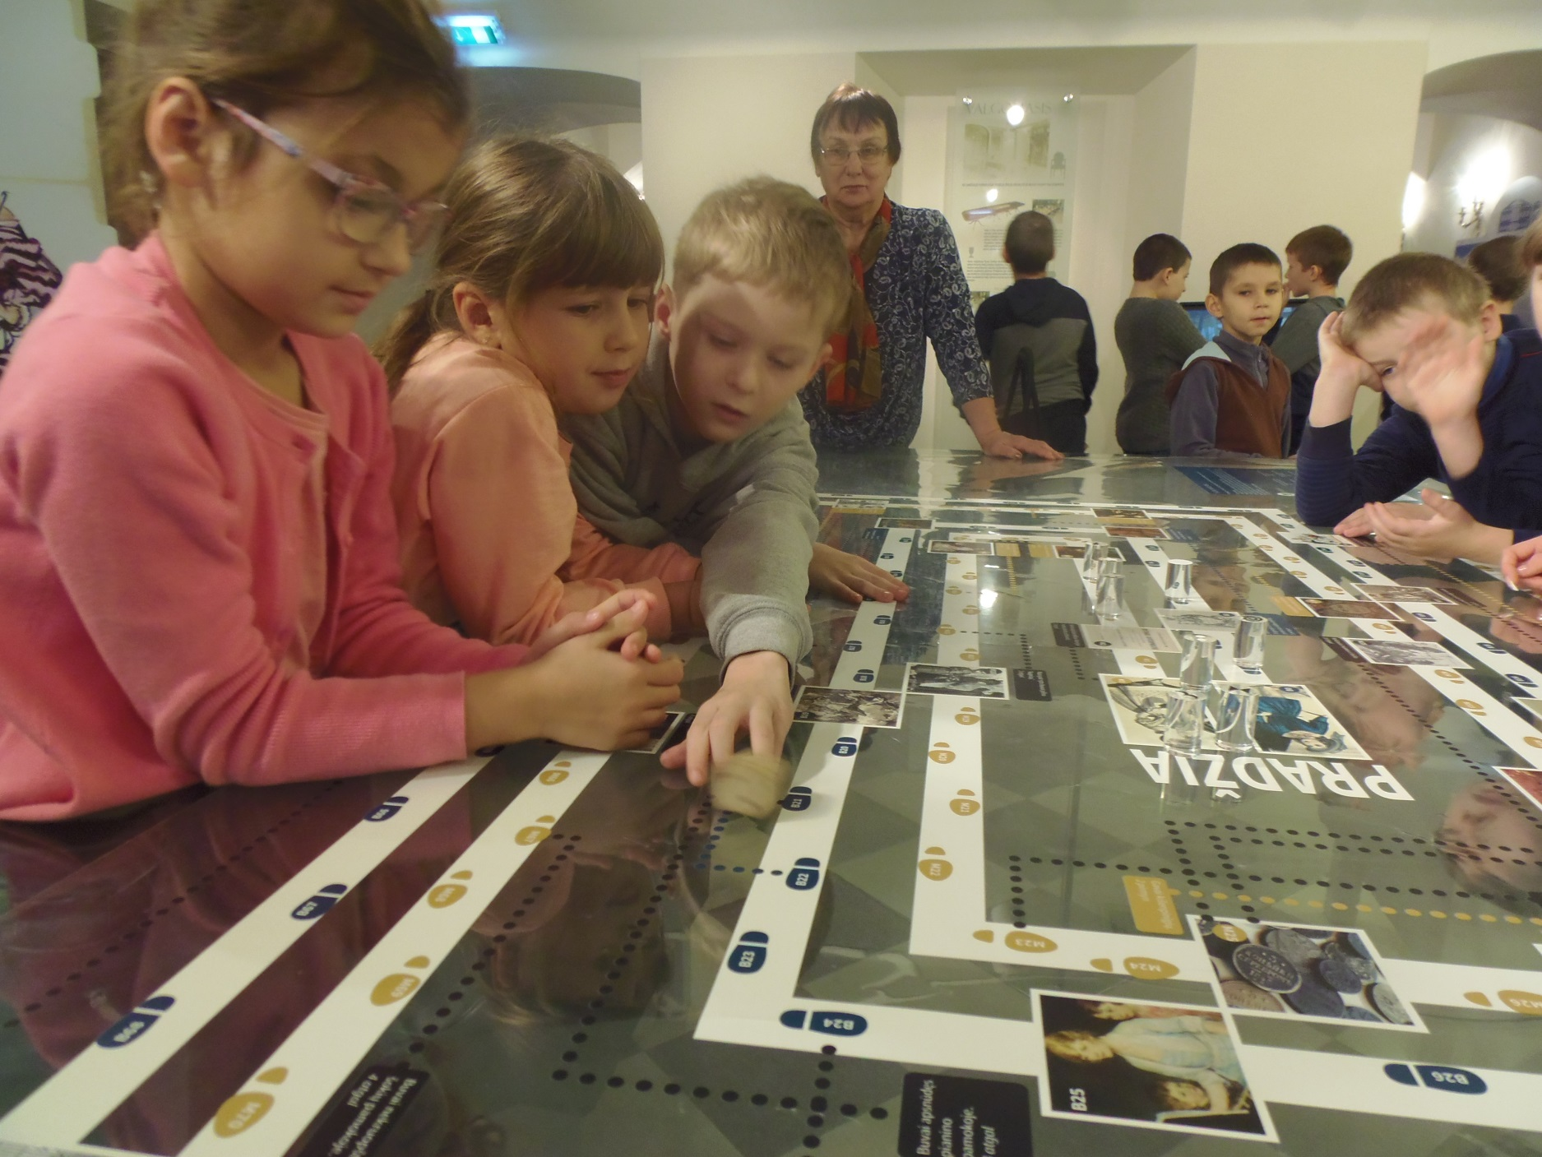
The primary school children at the Jašiūnai palace

Slide 33
The Independence Day festival for primary school students

Slide 34
The primary school students in the vocational school

Slide 35
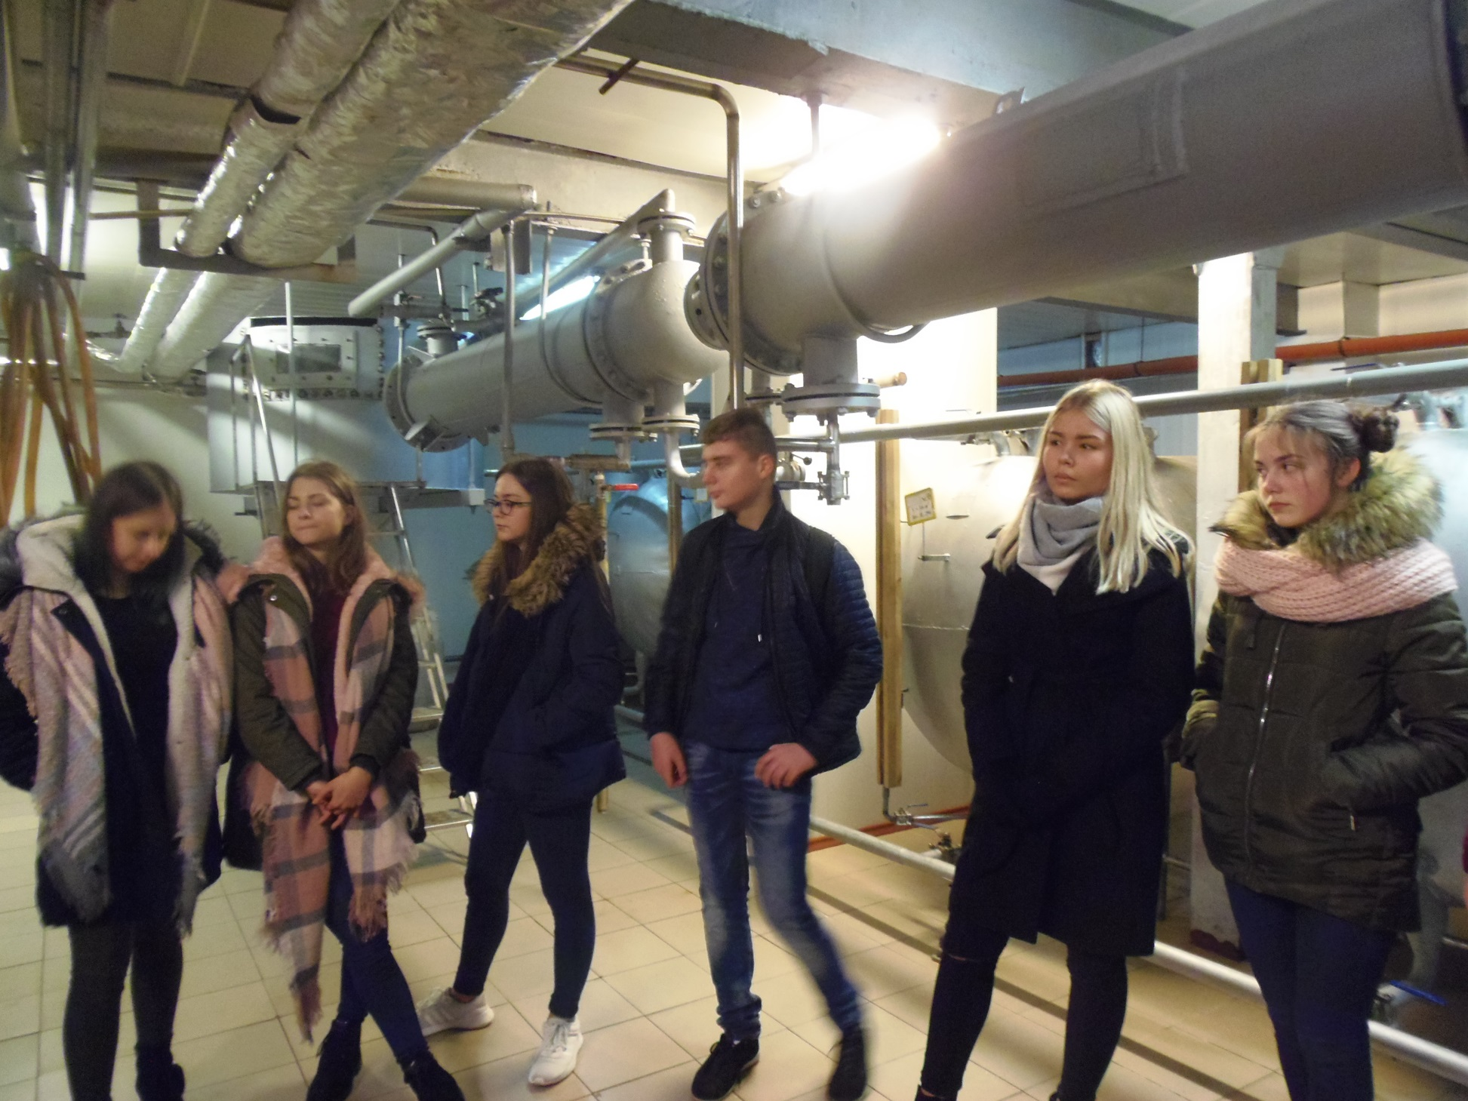
Professional orientation lessons in the Jašiūnai vinegar factory

Slide 36
The professional orientation lesson ,,at the Levandas port“

Slide 37
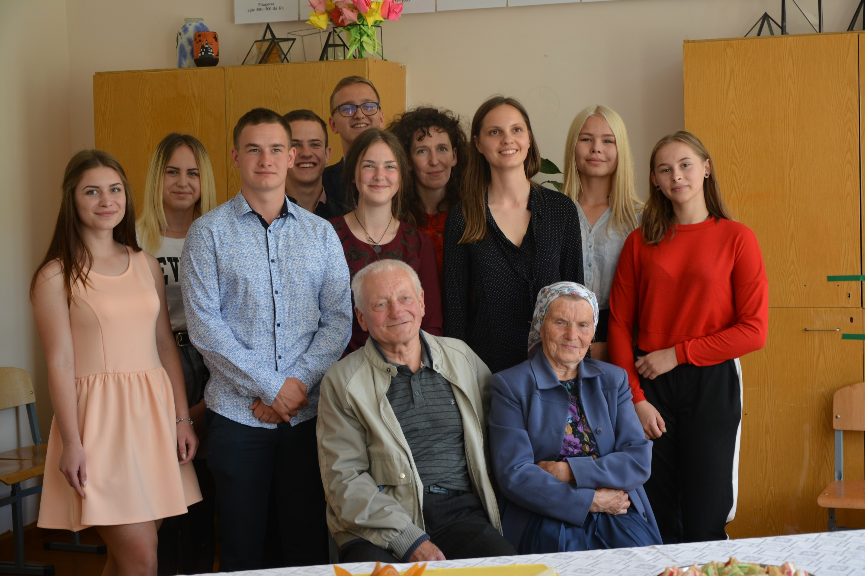
Project ,,The social education , by involving biographycal and theatre methods: Šalčininkų district case

Slide 38
The first day at school

Slide 39
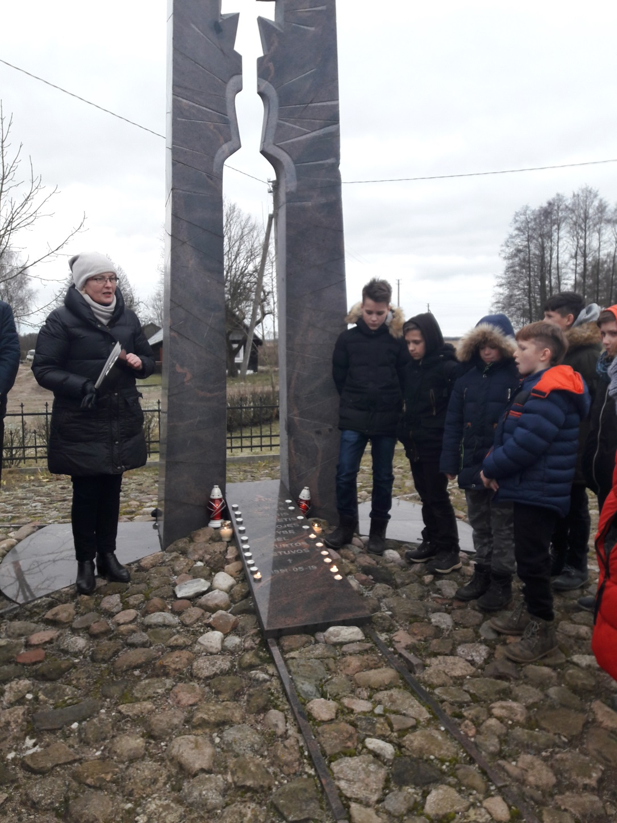
Were are remembering people killed in Freedom fighting battles

Slide 40
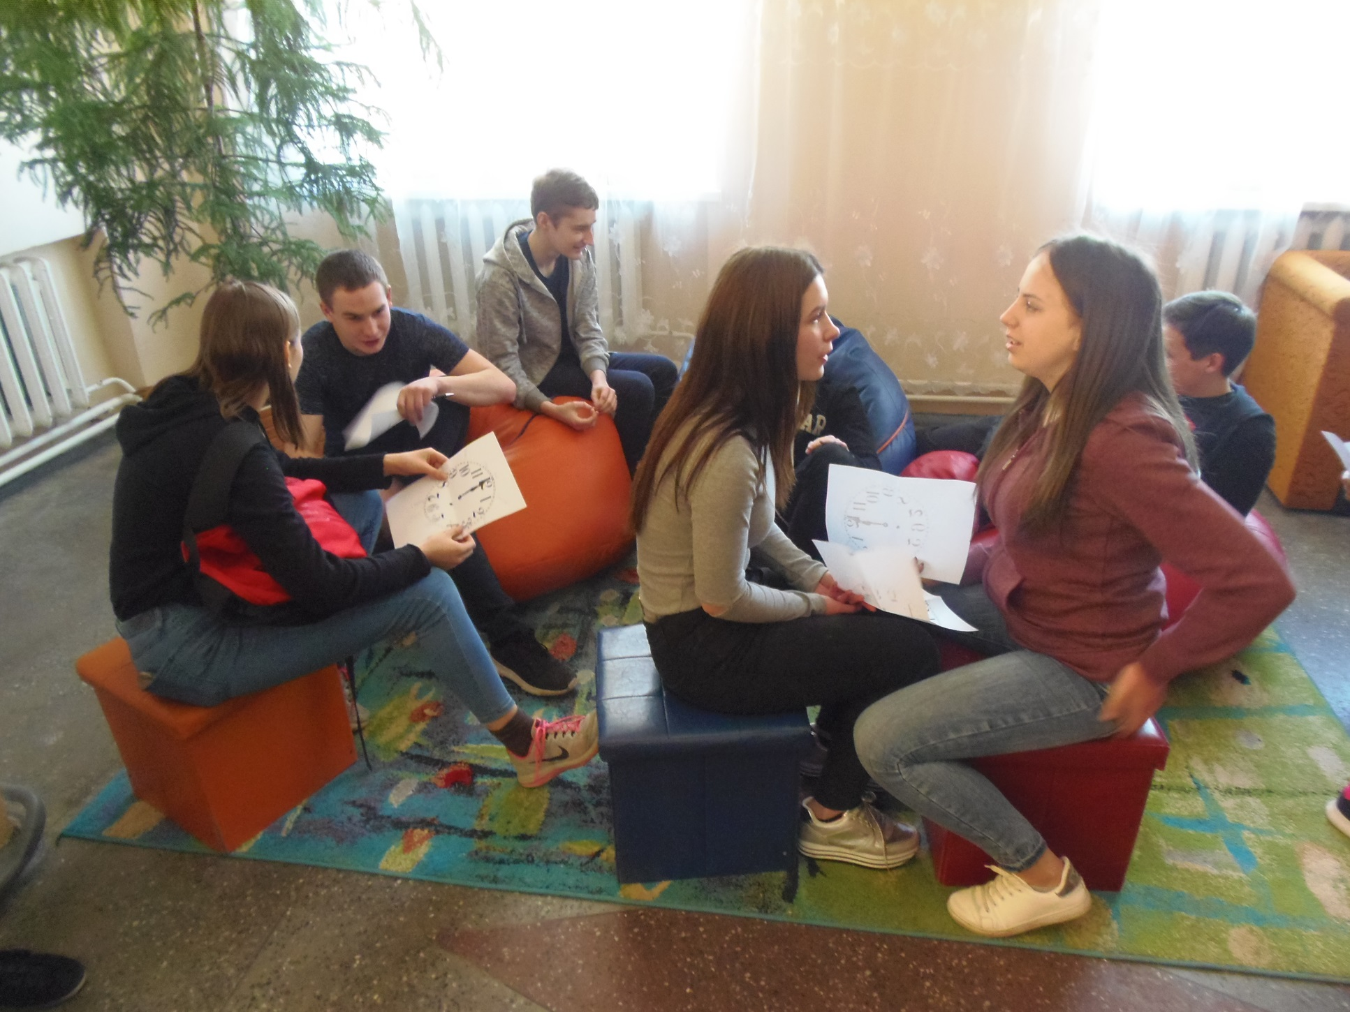
A week without teasing

Slide 41
The Shrove Tuesday

Slide 42
St. Valentines day

Slide 43
The commemoration of the Independence Day on the 16 th February

Slide 44
The trip of Independence Day in Šalčininkai

Slide 45
The summer camp

Slide 46
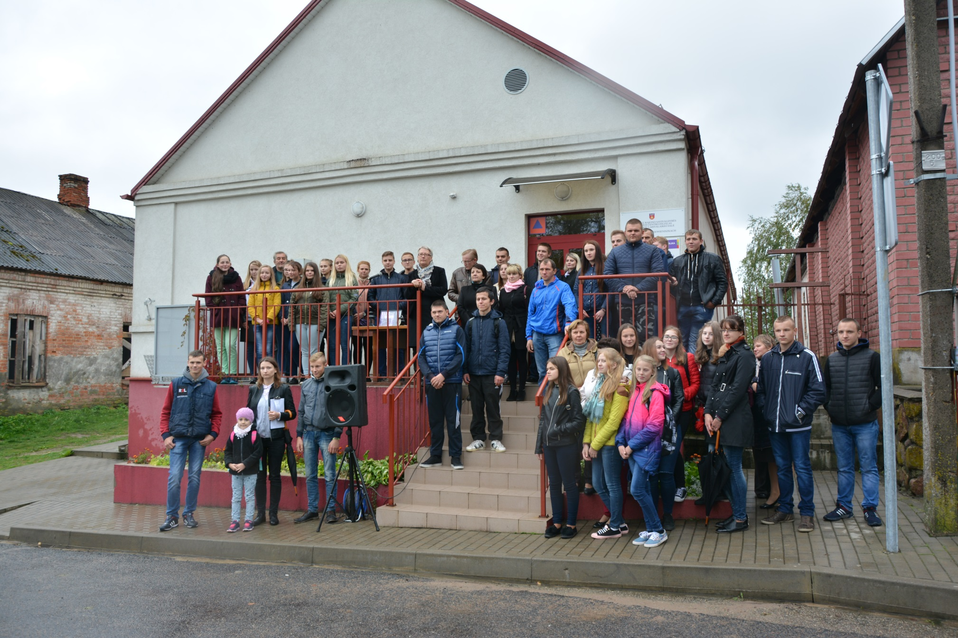
The commemoration of the Jewish genocide day

